Slide 1
Unix Kernel
Sarmistha Neogy
Reference:
The Design of the UNIX Operating System
by Maurice J. Bach

Slide 2
Introduction to Kernel
Kernel Architecture
File System
Process

Slide 3
Kernel Architecture (UNIX)
User program
Library
User level
system call interface
kernel level
File Subsystem
Inter process
communication
Buffer Cache
Process Control
Subsystem
Scheduler
Memory Management
character block
Device driver
Hardware control
kernel level
hardware

Slide 4
File System
A file system is consisted of a sequence of logical blocks (512/1024 byte etc.)
A file system has the following structure:
Boot Block | Super Block | Inode List | Data Blocks

Slide 5
File System: Boot Block
The beginning of the file system
Contains bootstrap code to load the operating system
Initializes the operating system
Typically occupies the first sector of the disk

Slide 6
File System: Super Block
Describes the state of a file system
Describes the size of the file system
How many files it can store
Where to find free space on the file system
Other information

Slide 7
Contents of Super Block
Size of filesystem
No. of free blocks in filesystem
List of free blocks in filesystem
Index of next free block in free block list
Size of inode list
No. of free inodes in filesystem
List of free inodes in filesystem
Index of next free inode in inode list
Lock fields for free block and free inode lists
A flag indicating that superblock has been modified

Slide 8
File System: Inode List
Inodes are used to access disk files.
Inodes maps the disk files
For each file there is an inode entry in the inode list block
Inode list also keeps track of directory structure

Slide 9
File System: Data Block
Starts at the end of the inode list
Contains disk files
An allocated data block can belong to one and only one file in the file system

Slide 10
Process
A process is a program in execution
A process consists of text (machine code), data and stack
A process reads and writes its data and stack sections, but it cannot (and should not) read or write the data and stack of other processes
A process communicates with other processes and the rest of the world via system calls

Slide 11
Process …
A number of processes can run simultaneously as kernel schedules them for execution
Several processes may be instances of one program

Slide 12
Process ..
Kernel has a process table that keeps track of all active processes
Each entry in the process table contains pointers to the text, data, stack and the U Area of a process.
All processes in UNIX system, except the very first process (process 0) which is created by the system boot code, are created by the fork system call

Slide 13
Kernel Support for Process
Kernel Process Table
Kernel Region Table
A Process
Per Process Region Table
Text
File Descriptor Table
Data
Stack
U Area

Slide 14
Process: Region Table
A region is a contiguous area of a process's address space, such as text, data and stack. Region table entries describes the attributes of the region, such as whether it contains text or data, whether it is shared or private
The extra level from the per process region table to kernel region table allows independent processes to share regions.

Slide 15
Process: U Area
U Area is the extension of process table entry.
Fields of process table entry:
State field
User ID (UID)
Fields of U Area
Pointer to process table entry
File descriptors of all open files
Current directory and current root
I/O parameters
Process and file size limit
Signal handlers
Timers
User identifiers

Slide 16
Process: U Area
Kernel can directly access fields of the U Area of the executing process but not the U Area of other processes

Slide 17
Process Context
The context of a process is its state:
Text, data( variable), register
Process region table, U Area,
User stack and kernel stack
When executing a process, the system is said to be executing in the context of the process.

Slide 18
User level Context
Consists of user programs and can be generated from the compiled object file. User program is separated into text and data. Text area is read only (i.e. the program), and data is the data that program needs. User stack is used for procedure calls etc.
Notes:
There is a shared space. Physically it is just one area for all process, i.e. there is only one copy of it, but because of virtual memory it appears to each sharing process that the shared memory region is in its address space When a process is not running, the process status information is stored in the register context.

Slide 19
Register Context
Program Counter
Processor Status Register
Stack Pointer
General-purpose Registers

Slide 20
System level Context
Static –
process table entry - Process table entry consists of information about current state of process, process id, priority, memory status –whether it is in main or swapped out, pointer to next link (process) in the ready Q
U Area Context
per process region table
Notes:
U Area Context, that kernel needs when executing a process in the context of the user. The third static portion is the per process region table - that defines the mapping from virtual to physical address space, as well the permissions e.g. read only.

Slide 21
System level Context
Dynamic –
kernel stack – used in kernel mode - contains the information that must be saved and restored as procedure calls and interrupts occur.

Slide 22
Context Switch
When the kernel decides that it should execute another process, it does a context switch, so that the system executes in the context of the other process
When doing a context switch, the kernel saves enough information so that it can later switch back to the first process and resume its execution.

Slide 23
Mode of Process Execution
A process in UNIX may run in two modes:
User mode
Can access its own instructions and data, but not kernel instruction and data
Kernel mode
Can access kernel and user instructions and data
When a process executes a system call, the execution mode of the process changes from user mode to kernel mode

Slide 24
Mode of Process Execution ..
When moving from user to kernel mode, the kernel saves enough information so that it can later return to user mode and continue execution from where it left off.
Mode change is not a context switch, just change in mode.

Slide 25
Process States
Process mode and states:
The process is running in user mode
The process is running in kernel mode
The process is not executing, but it is ready to run as soon as the scheduler chooses it
The process is sleeping
Such as waiting for I/O to complete

Slide 26
Process State Transition
1
user running
system call
or interrupt
return
2
Interrupt return
kernel running
sleep
schedule process
4
3
asleep
ready to run
wakeup
context switch
permissible

Slide 27
Process State Transition ..
The kernel allows a context switch only when a process moves from the state kernel running to the state asleep
Process running in kernel mode cannot be preempted by other processes.

Slide 28
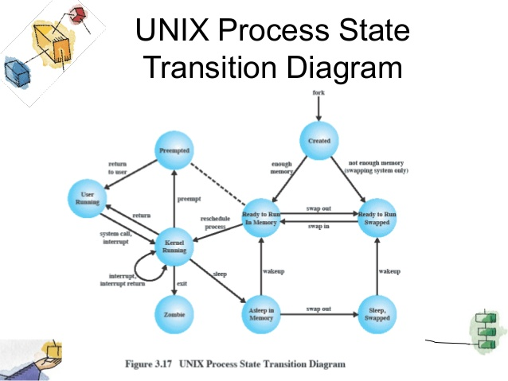

Slide 29
Fork
The following figure shows the relevant data structures of a running process.
When a process issues a fork system call, the kernel duplicates the address space of the old process, allowing processes to share regions when possible and making a physical copy otherwise. When a process issues a exit call, the kernel frees the regions the process had used. The process table points to a per process region table with pointers to the region table entries for the text, data and stack regions of the process.

Slide 30
Fork System Call ..
stack
Parent
Child
Region
table
data
text
U Area
stack
U Area
data
Region
table
Kernel File
Table
Kernel Region
Table

Slide 31
References
http://www.employees.org/~tjsundar/html/tutorials/unixprocesses.html
http://www.employees.org/~tjsundar/html/tutorials/unixprocesses.html

Slide 32
Thank You

